Slide 1
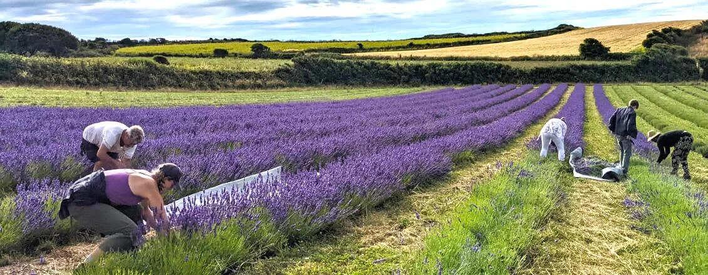
Forests for Cornwall Agroforestry Exemplar at
Forests For Cornwall - Winter 23/24 Project

Slide 3
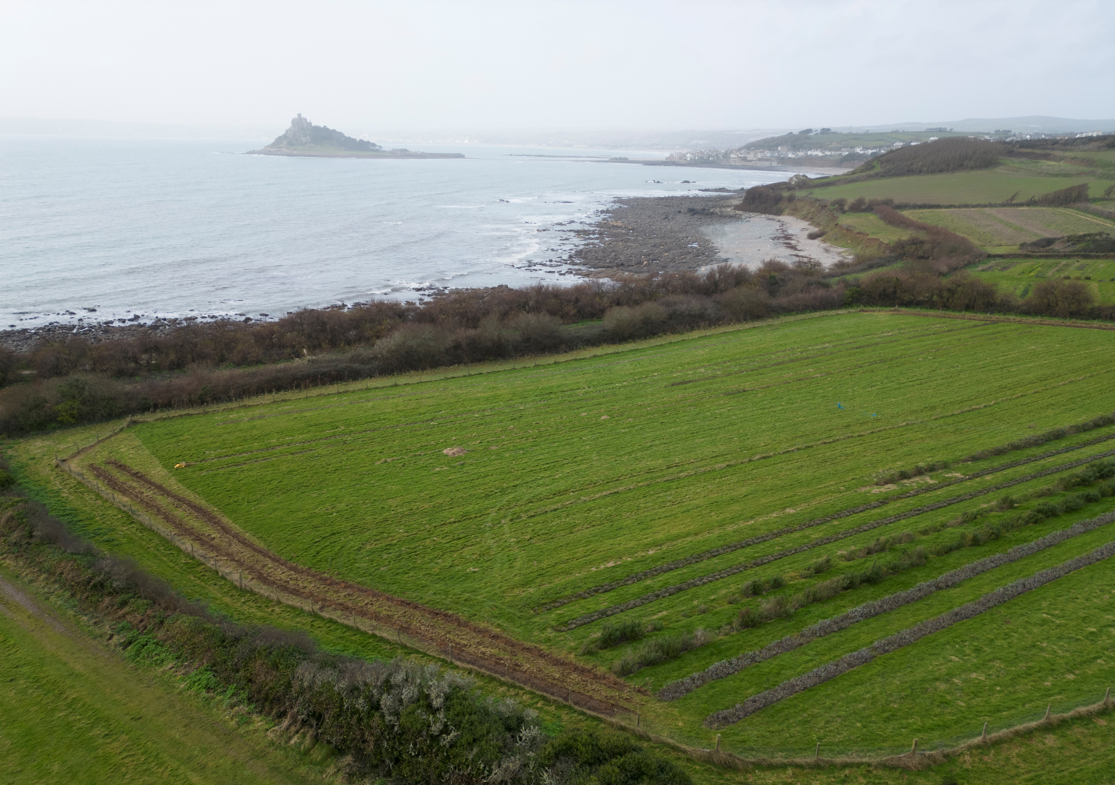

Slide 4
The key aims of the Exemplar Project at Trenow Fields are:
To improve the growing environment, both above and below ground.
To improve the biodiversity potential of the site and support nature recovery.
To provide climate resilience to the Landholding.
To demonstrate alternative tree planting methodologies.
To provide future learning and research opportunities.

Slide 5
During the last three months we have planted:
700m of shelterbelts
300m of native hedgerows
0.35ha of tree groups and habitat expansion
A new orchard
No plastic tree guards to protect the new plantings, opting for the installation of rabbit fencing and the creation of bespoke, individual guards using rabbit netting and bamboo caneswhere necessary and unguarded in less prone areas

Slide 6
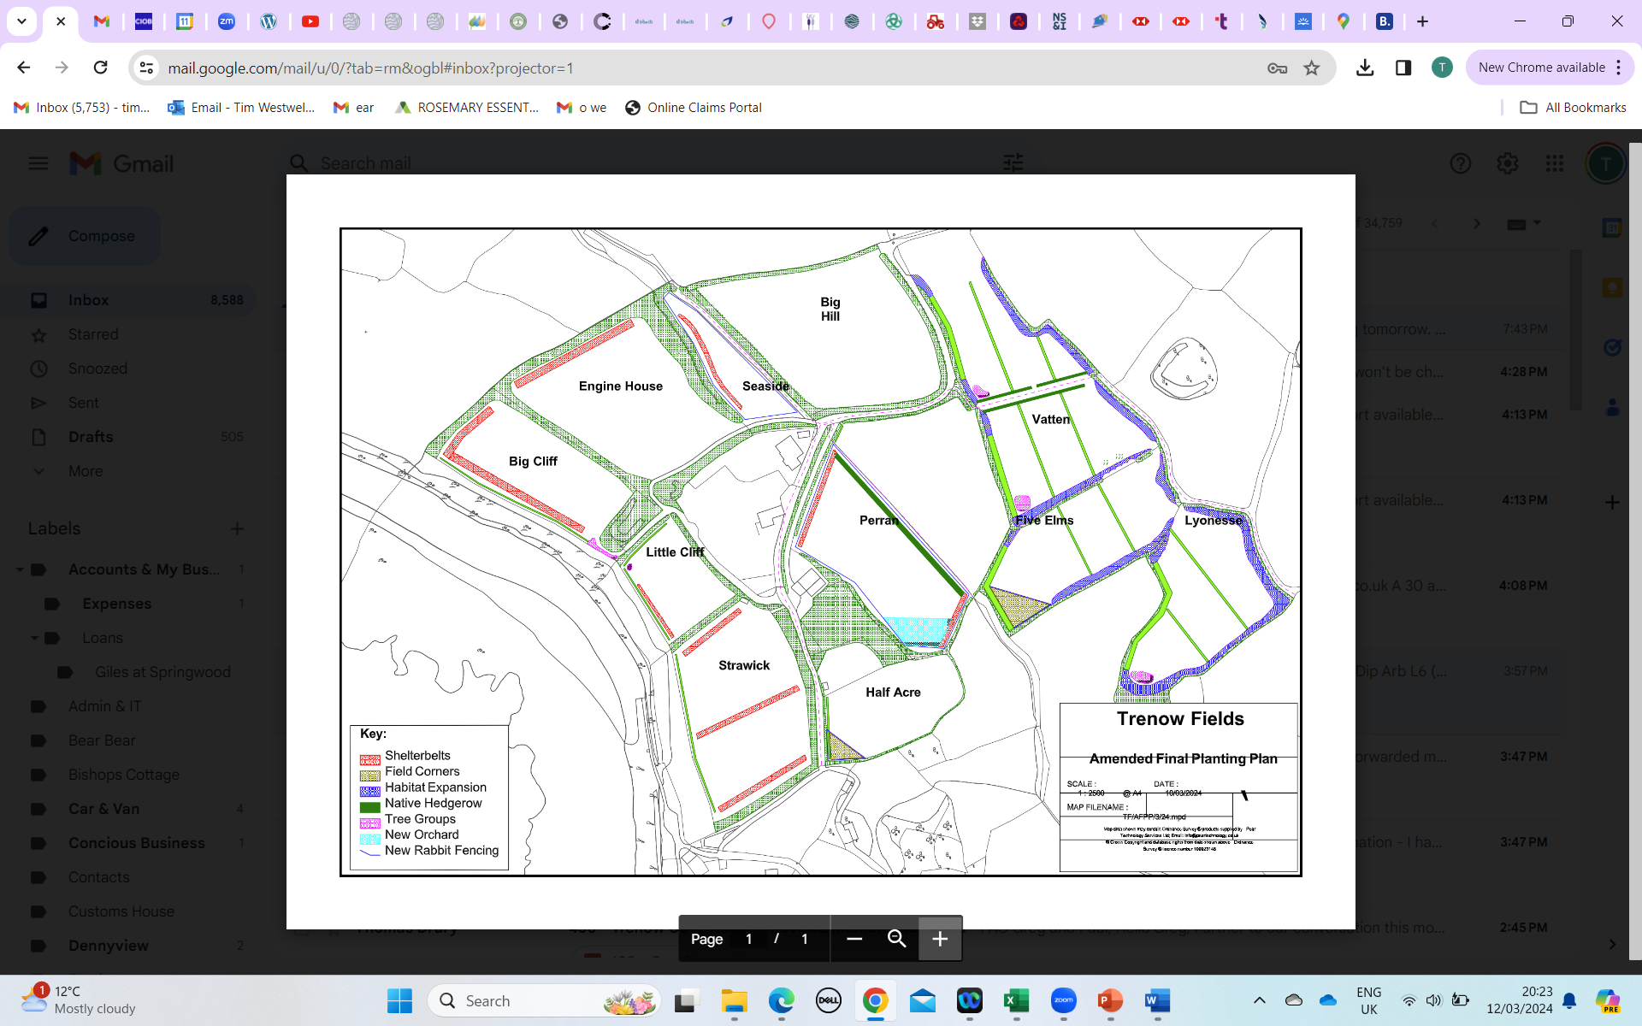

Slide 7
The Tree Groups
The Landholding covers an area of approximately 12ha. 9ha is rented from the National Trust and 3ha is under private ownership.
National Trust policy is that only native tree and shrub species are planted within the land under their ownership.
There are a number of non-native species that are better suited to coastal exposure than native species (e.g. Holm oak, white poplar, Swedish whitebeam and Italian alder). A selection have been selected and planted within the privately owned land. Eg Sea Buckthorn
The rates of growth and establishment of the non-native trees, and their future health and condition, will be monitored, and compared, to the native species planted within the National Trust owned land.

Slide 8
Central to Design – Shelterbelts for coastal location
Native willow species (Grey, white and osier) planted in double staggered rows along the most exposed boundaries of the lower fields.
Once established, aside from the primary requirement for wind protection, the shelterbelts are intended to provide an ongoing supply of ramial wood-chippings (i.e. produced from stems ≤ 1 year old) *
Alternate, annual coppicing of each row within the shelterbelts will maintain a consistent degree of wind protection.
* The ramial wood-chippings will be utilised as a mulch to support the productivity of the site by suppressing weeds, regulating moisture levels and slowly releasing nutrients, whilst improving the soil’s health, structure and fertility. Pure willow mulches also contain salicylic acid (concentrations vary between species) which can control disease as effectively as agrochemicals and only require one application for the entire growing season.

Slide 9
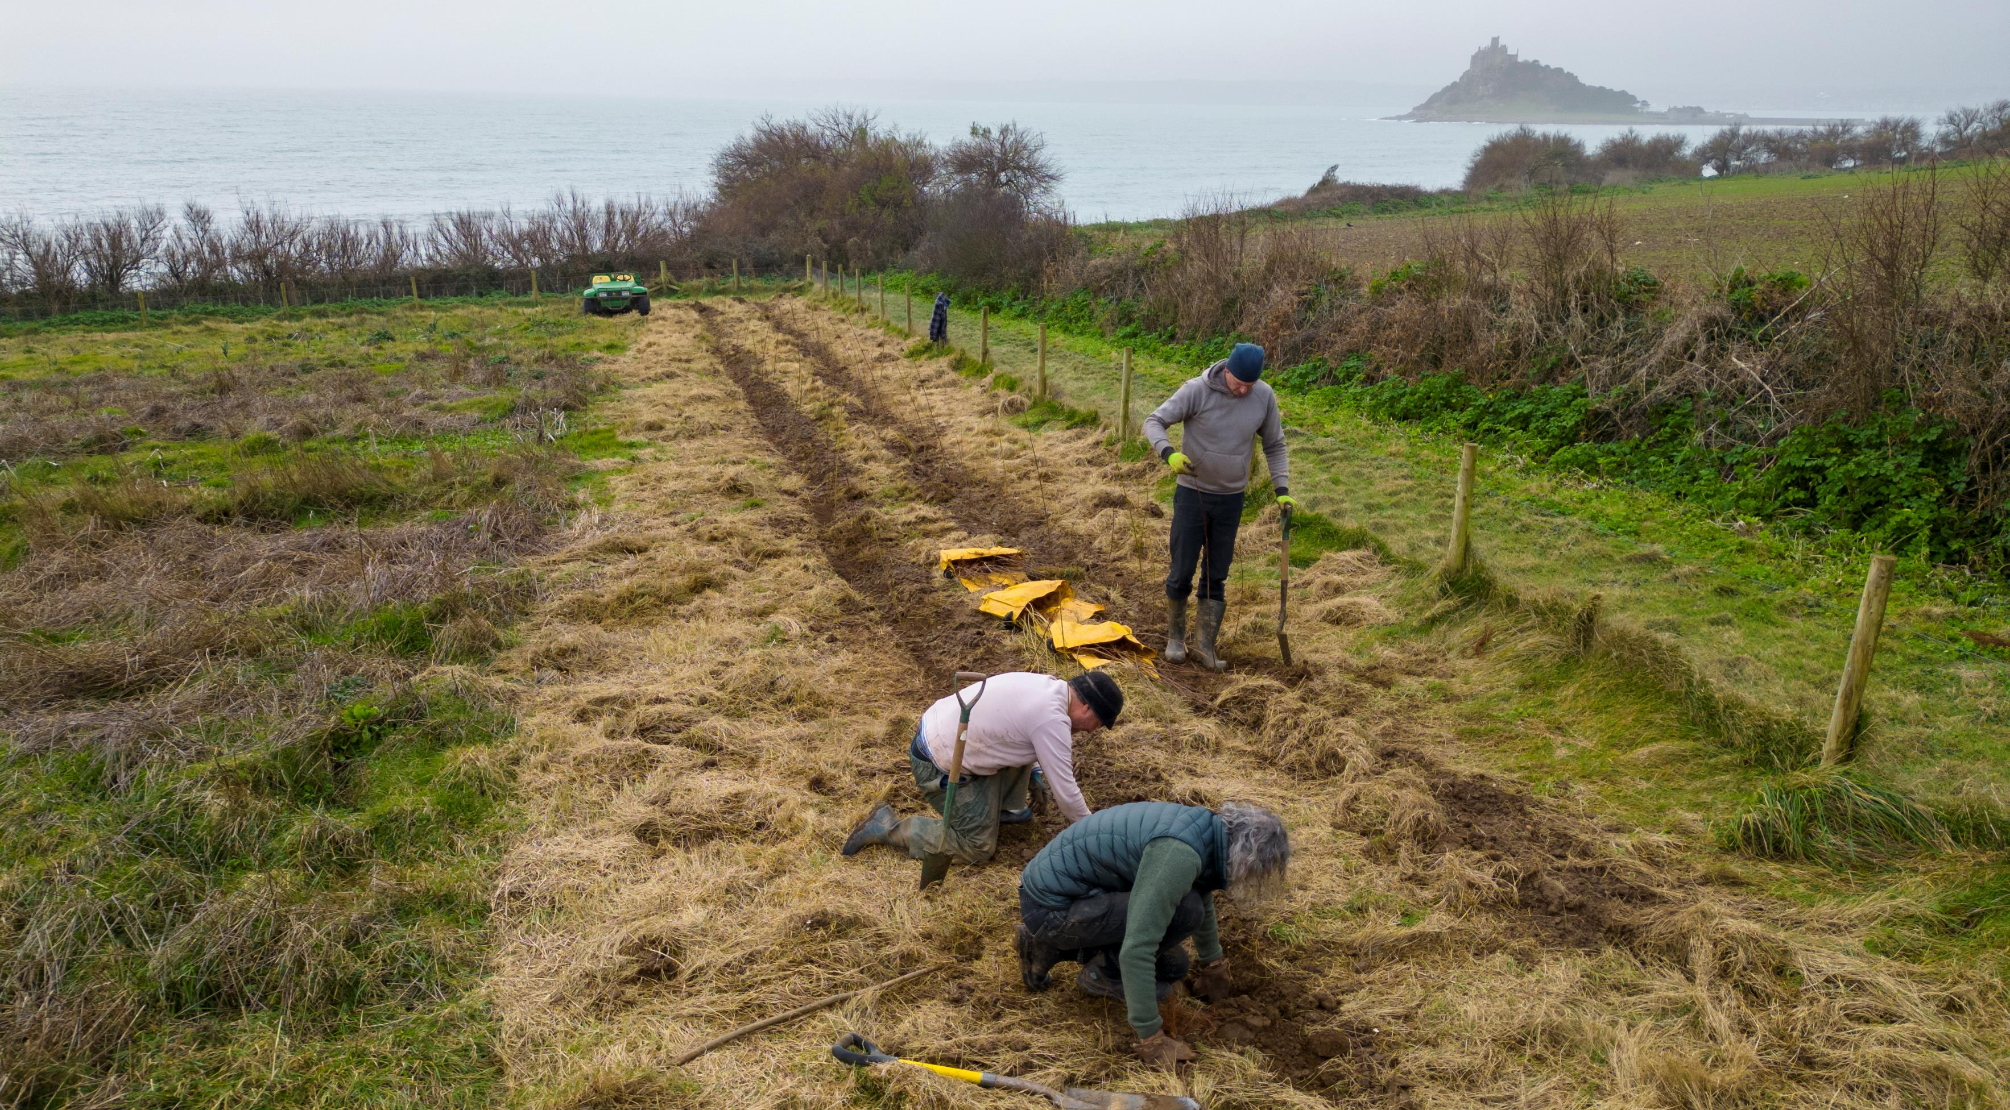

Slide 10
The Native Hedgerows
The native hedgerows that have been planted are intended to offer a range of benefits once established.
The hedgerows have been planted predominantly with wild privet, holly, hawthorn and hazel, with occasional rowan, crab apple and alder buckthorn.
They now demarcate the Public Rights of Way that cross the site, and will control public access (and hopefully dogs!), whilst providing shelter, a connective, protective habitat, foraging opportunities for local wildlife populations and also supporting insect pollinators and pollination within the site.

Slide 11
Habitat Expansion
Designed through adopting an assisted natural regeneration approach.
The traits of sea buckthorn and blackthorn for ‘creeping’ through root suckering, and buddleia and grey willow, for spreading through seed dispersal, will be strategically exploited around the boundaries of the easternmost, privately owned fields.
The purpose of these plantings is primarily to create new scrub habitat and consolidate and expand the existing boundary vegetation. Potential to also to seasonally harvest berries from the sea buckthorn and blackthorn (sloes).
Once established, the enhanced boundaries will locally provide increased shelter and pollinator benefits that will, in turn, support future productivity within this currently fallow part of the site.
Inter-planting with productive, named varieties of sea buckthorn will also be considered in the future

Slide 12
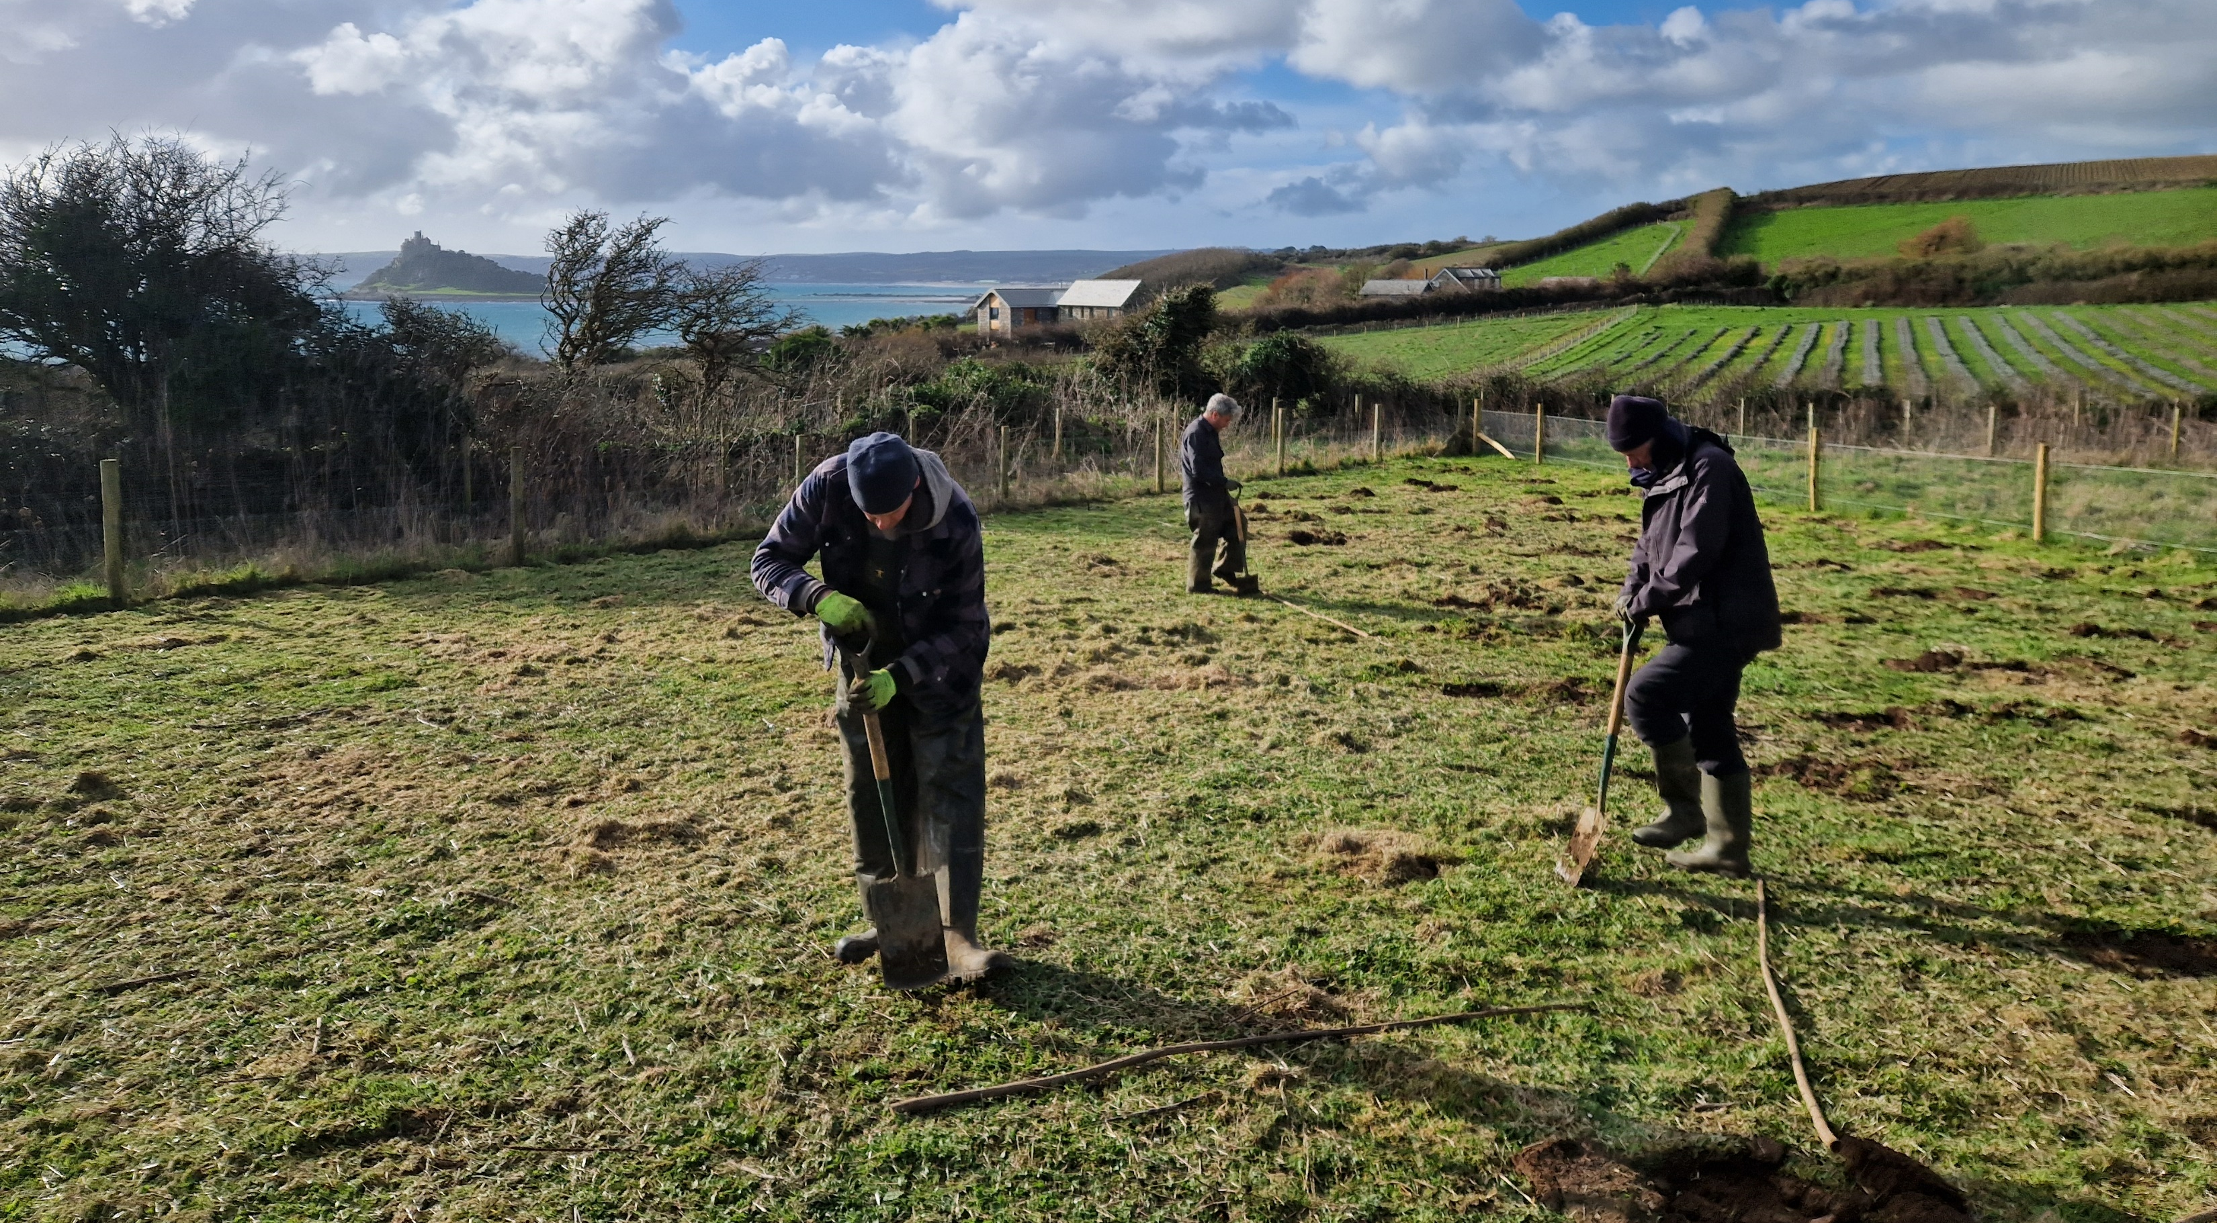

Slide 13
Learnings & Sharings
The degree of funding available from the Agroforestry Exemplar Grant, and the flexibility regarding planting specifications, has greatly benefited the design and delivery of the new plantings, allowing scope to innovate and challenge typical planting practices.
The professional support and guidance has been essential and ensured that the Project was successfully delivered on time, but not necessarily on budget!
The importance of skilled labour. Tree planting is a relatively straightforward task; however, effective, efficient delivery does require underpinning skills, the correct mindset and a strategic approach to be adopted.
Newly planted trees do not all require to be wrapped in plastic.
Exploiting any micro-climates created through the leeside protection (hedges, buildings and topography) is essential. Shelter provides opportunity to promote successful establishment, growth and productivity.
Every day is a school day, and lessons will continue to be learned over the forthcoming growing seasons as the trees establish.

Slide 14
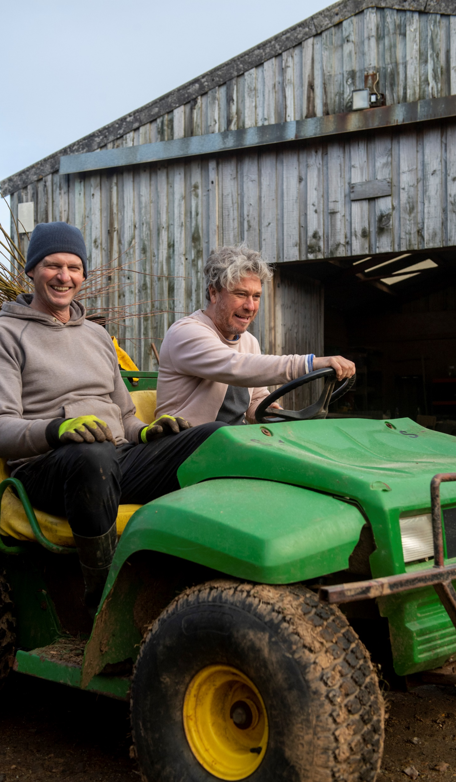
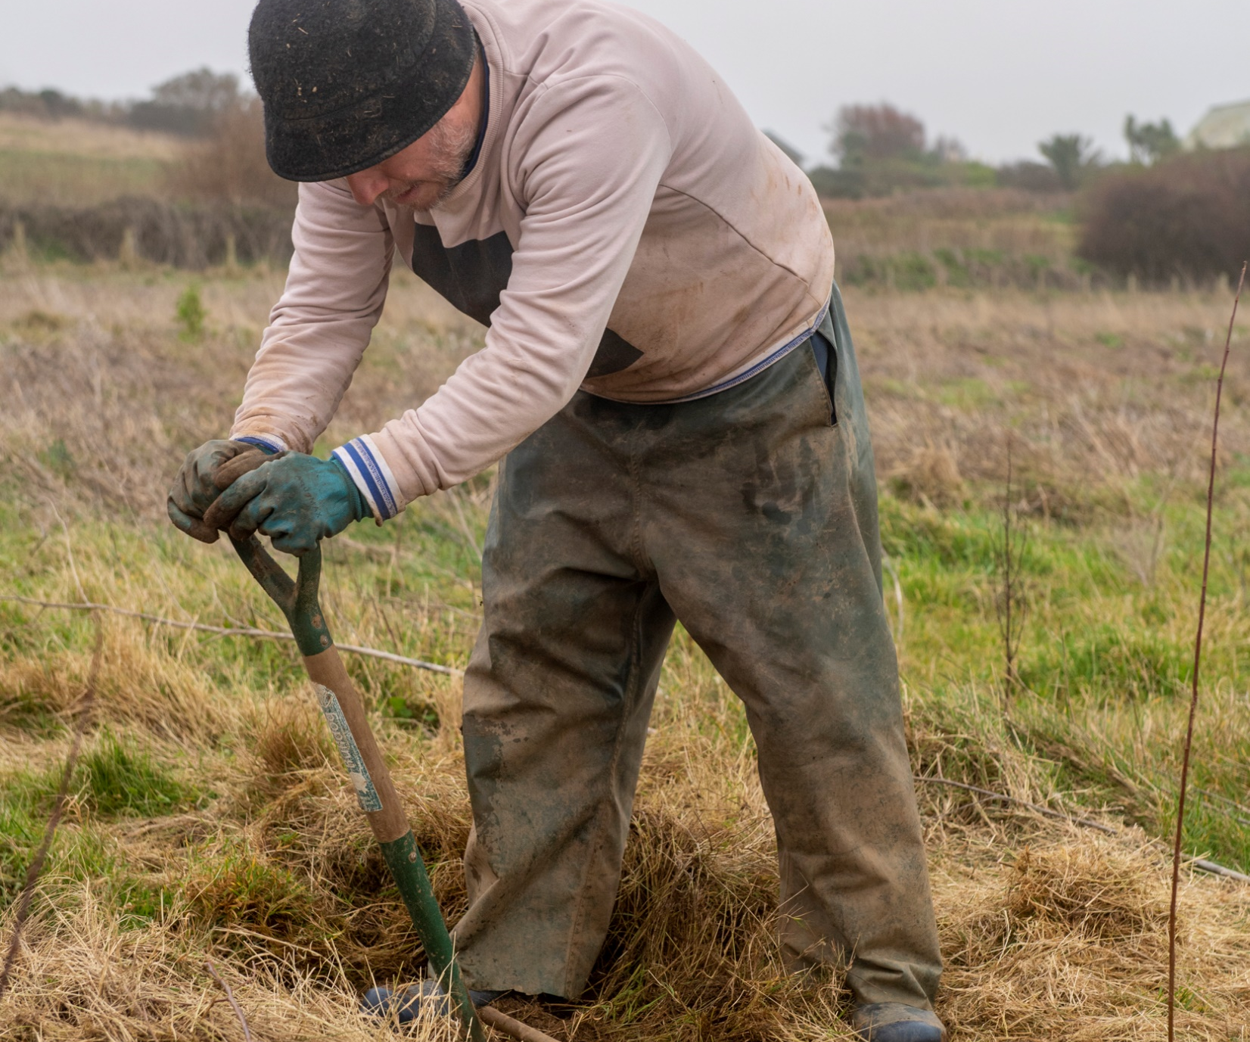

Slide 15
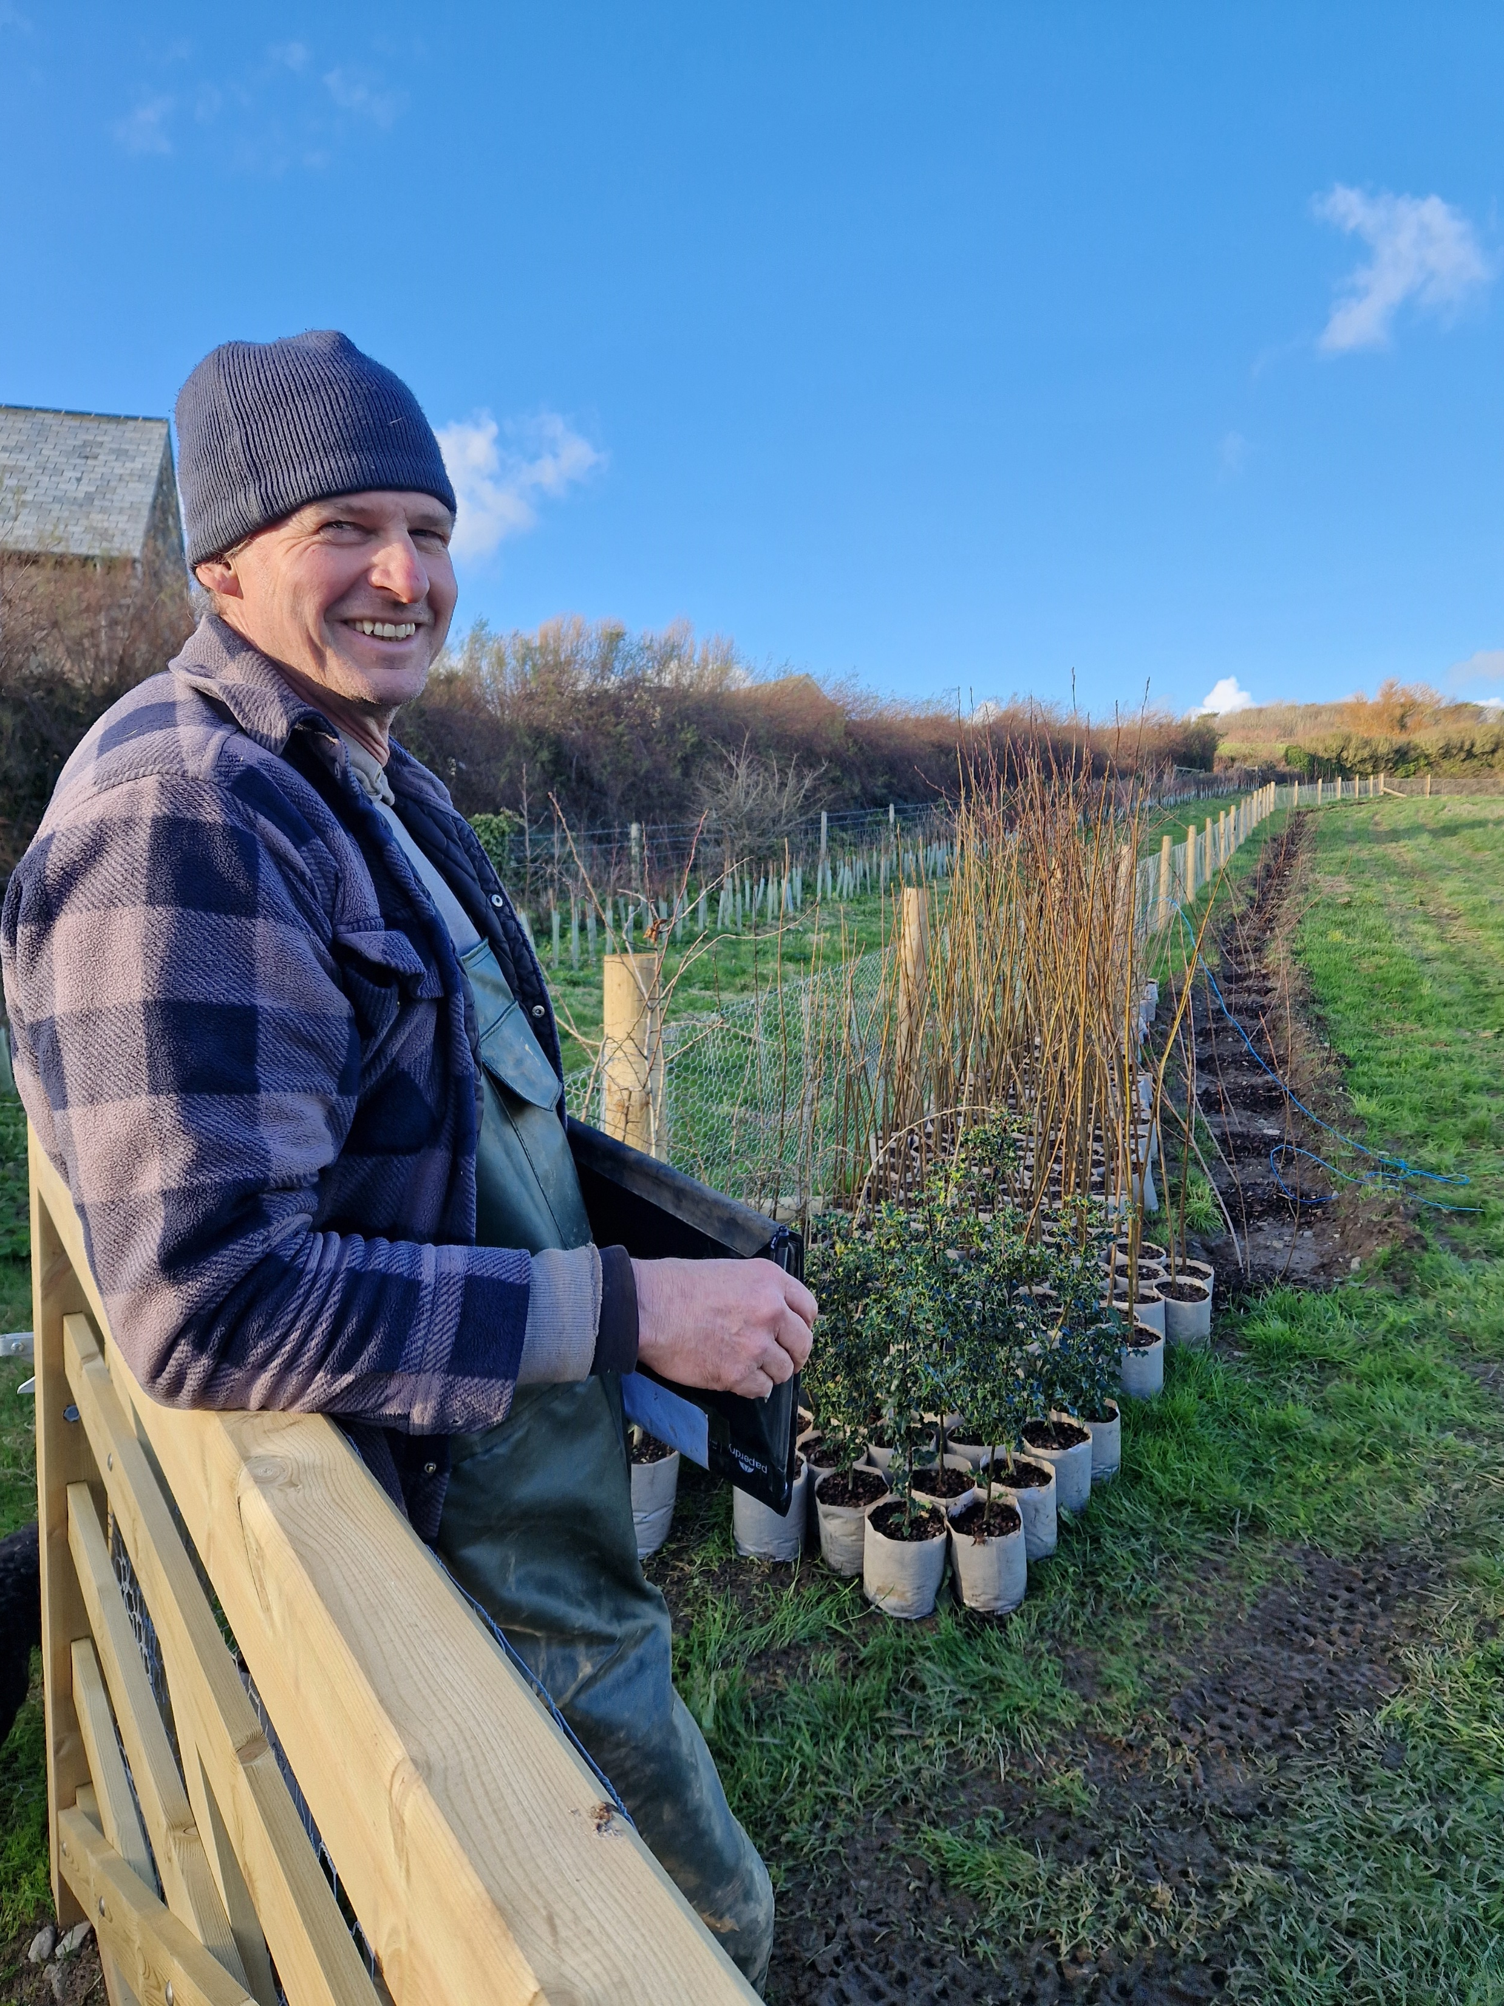
TREEmendous
thanks to:
Steve Evans
&
Forests For
Cornwall

